Slide 1
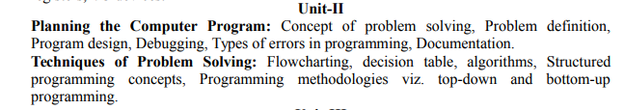

Slide 2
Concept of Problem Solving
A computer cannot solve a problem on its own. One has to provide step by step solutions of the problem to the computer. In fact, the task of problem solving is not that of the computer. It is the programmer who has to write down the solution to the problem in terms of simple operations which the computer can understand and execute.

Slide 3
Concept of Problem Solving
In order to solve a problem by the computer, one has to pass though certain stages or steps. They are
    1. Understanding the problem
    2. Analyzing the problem
    3. Developing the solution
    4. Coding and implementation.

Slide 4
Concept of Problem Solving
1. Understanding the problem: Here we try to understand the problem to be solved in totally. Before with the next stage or step, we should be absolutely sure about the objectives of the given problem.
2. Analyzing the problem: After understanding thoroughly the problem to be solved, we look different ways of solving the problem and evaluate each of these methods. The idea here is to search an appropriate solution to the problem under consideration. The end result of this stage is a broad overview of the sequence of operations that are to be carries out to solve the given problem.

Slide 5
Concept of Problem Solving
3. Developing the solution: Here the overview of the sequence of operations that was the result of analysis stage is expanded to form a detailed step by step solution to the problem under consideration.
4. Coding and implementation: The last stage of the problem solving is the conversion of the detailed sequence of operations in to a language that the computer can understand. Here each step is converted to its equivalent instruction or instructions in the computer language that has been chosen for the implementation.

Slide 6
Program Design / How to write a Program
To write a program for a computer to follow, we must go through a two-phase process:
    problem solving and
    implementation

Slide 7
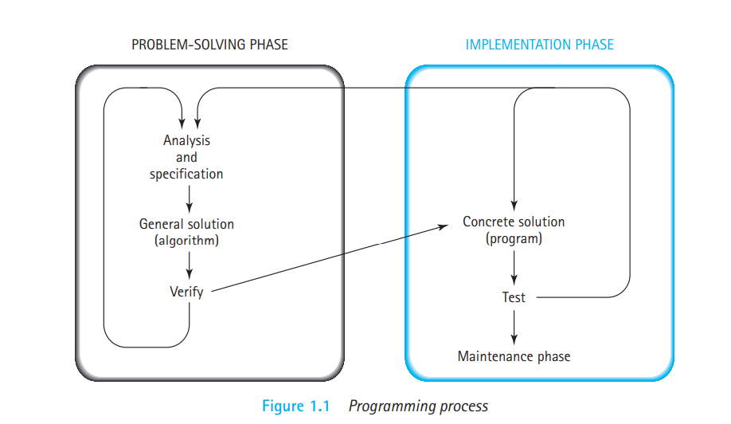
Program Design / How to write a Program

Slide 8
Program Design / How to write a Program
Problem-Solving Phase:
  1. Analysis and Specification: Understand (define) the problem and what the solution must do.
  2. General Solution (Algorithm): Specify the required data types and the logical sequences of steps that solve the problem.
  3. Verify: Follow the steps exactly to see if the solution really does solve the problem.

Slide 9
Program Design / How to write a Program
Implementation Phase
  1. Concrete Solution (Program): Translate the algorithm (the general solution) into a programming language.
  2. Test: Have the computer follow the instructions. Then manually check the results. If you find errors, analyze the program and the algorithm to determine the source of the errors, and then make corrections.
Once a program has been written, it enters a third phase: maintenance.

Slide 10
Program Design / How to write a Program
Maintenance Phase
  1. Use: Use the program.
  2. Maintain: Modify the program to meet changing requirements or to correct any errors that show up while using it.

Slide 11
Computer program is data type specifications and instructions for carrying out operations that are used by a computer to solve a problem.
Computer programming is the process of specifying the data types and the operations for a computer to apply to data in order to solve a problem.
Data type is the specification of how information is represented in the computer as data and the set of operations that can be applied to it.

Slide 12
Debugging
Programming is a complex process, and because it is done by human beings, it often leads to errors.
Programming errors are called bugs and the process of tracking them down and correcting them is called debugging. Coders should debug the smallest of their modules before moving on. This decreases the number of errors thrown up during the testing phase and reduces testing time and effort significantly.

Slide 13
Types of Errors
Three types of errors:
  Syntax Errors
  Runtime Errors
  Logical Errors/ Semantic Errors

Slide 14
Syntax errors
Any violation of rules and poor understanding of
programming language results in syntax errors. In effect, syntax errors represent grammar errors in the use of the programming language. Common examples are:
    Misspelled variable and function names
    Missing semicolons
    Improperly matches parentheses, square brackets, and curly braces
    Incorrect format in selection and loop statements

Slide 15
Runtime Errors
Runtime errors occur when a program with no syntax errors asks the computer to do something that the computer is unable to reliably do. These errors are also called exceptions because they usually indicate that something exceptional (and bad) has happened.
Common examples are:
    Trying to divide by a variable that contains a value of zero
    Trying to open a file that doesn't exist

Slide 16
Semantic/Logical Errors
As the name itself implies, these errors are related to the logic of the program. These errors occur due to incorrect translation of algorithm into the program, poor understanding of the problem and a lack of
clarity of hierarchy of operators.
Common examples are:
    Multiplying when you should be dividing
    Adding when you should be subtracting
    Opening and using data from the wrong file
    Displaying the wrong message

Slide 17
Documentation
Program documentation includes hard-copy or electronic manuals that enable users, program developers, and operators to interact successfully with a program.
The program documentation is a kind of documentation that gives a comprehensive procedural description of a program.
The program documentation describes what exactly a program does by mentioning about the requirements of the input data and the effect of performing a programming task.

Slide 18
Documentation
Internal documentation is written in a program as comments.
External documentation is written in a place where people who need to use the software can read about how to use the software. External documentation can be broken down into library documentation, which describes tools that a programmer can use, and user documentation, which is intended for users of an application.

Slide 19
Some guidelines for creating the documents
  Documentation should be from the point of view of the reader
  Document should be unambiguous
  There should be no repetition
  Industry standards should be used
  Documents should always be updated
  Any outdated document should be phased out after due recording of the phase out

Slide 20
Advantages of Documentation
Keeps track of all parts of a software or program
Maintenance is easier
Programmers other than the developer can understand all aspects of software
Improves overall quality of the software
Assists in user training
Ensures knowledge de-centralization, cutting costs and effort if people leave the system abruptly

Slide 21
Example Documents
A software can have many types of documents associated with it. Some of the important ones include −
User manual − It describes instructions and procedures for end users to use the different features of the software.
Operational manual − It lists and describes all the operations being carried out and their inter-dependencies.
Design Document − It gives an overview of the software and describes design elements in detail. It documents details like data flow diagrams, entity relationship diagrams, etc.
Requirements Document − It has a list of all the requirements of the system as well as an analysis of viability of the requirements. It can have user cases, reallife scenarios, etc.

Slide 22
Example Documents
Technical Documentation − It is a documentation of actual programming components like algorithms, flowcharts, program codes, functional modules, etc.
Testing Document − It records test plan, test cases, validation plan, verification plan, test results, etc. Testing is one phase of software development that needs intensive documentation.

Slide 23
Techniques of Problem Solving
FlowChart
A flowchart is a type of diagram that represents an algorithm, workflow, or process. The flowchart shows the steps as boxes of various kinds, and their order by connecting the boxes with arrows. This diagrammatic representation illustrates a solution model to a given problem.
The process of drawing a flowchart for an algorithm is known as “flowcharting”.

Slide 24
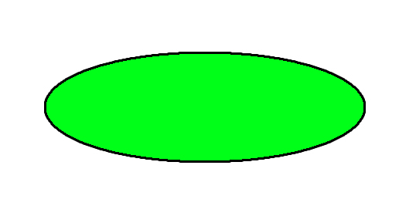
Basic Symbols used in Flowchart Designs
Terminal: The oval symbol indicates Start, Stop and Halt in a program’s logic flow. A pause/halt is generally used in a program logic under some error conditions. Terminal is the first and last symbols in the flowchart.

Slide 25
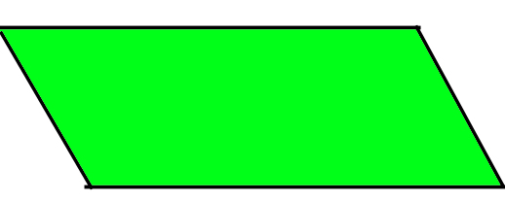
Basic Symbols used in Flowchart Designs
Input/Output: A parallelogram denotes any function of input/output type. Program instructions that take input from input devices and display output on output devices are indicated with parallelogram in a flowchart.

Slide 26
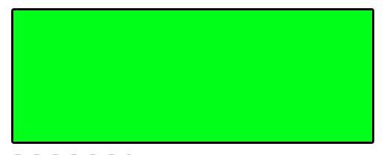
Basic Symbols used in Flowchart Designs
Process: The rectangle depicts a process such as a mathematical computation or a variable assignment.

Slide 27
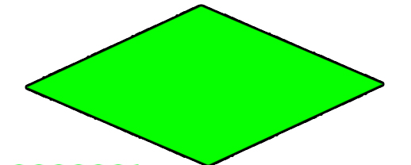
Basic Symbols used in Flowchart Designs
Decision: Diamond symbol represents a decision point. Decision based operations such as yes/no question or true/false are indicated by diamond in flowchart.

Slide 28
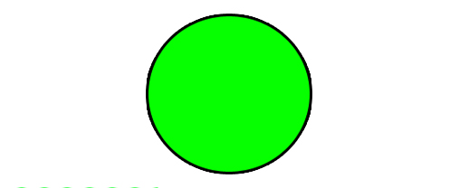
Basic Symbols used in Flowchart Designs
Connectors: Whenever flowchart becomes complex or it spreads over more than one page, it is useful to use connectors to avoid any confusions. It is represented by a circle.

Slide 29
Basic Symbols used in Flowchart Designs
Flow lines: Flow lines indicate the exact sequence in which instructions are executed. Arrows represent the direction of flow of control and relationship among different symbols of flowchart.

Slide 30
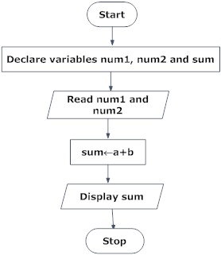
Draw a flowchart to add two numbers entered by user.

Slide 31
Determine and Output Whether Number N is Even or Odd
Algorithm:
Step 1: Read number N,
Step 2: Set remainder as N modulo 2,
Step 3: If remainder is equal to 0 then number N is even, else number N is odd,
Step 4: Print output.

Slide 32
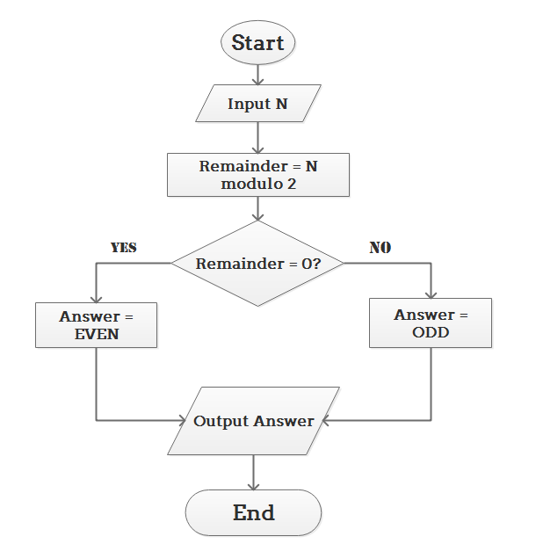

Slide 33
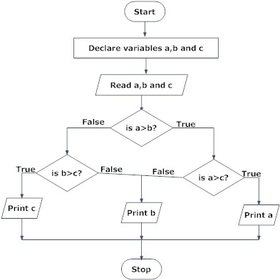
Draw flowchart to find the largest among three different numbers entered by user.

Slide 34
Is this number prime number or not?
Prime numbers are positive integers that can only be divided evenly by 1 or themselves. By definition, negative integers, 0, and 1 are not considered prime numbers. The list of the first few prime numbers looks like:
2, 3, 5, 7, 11, 13, 17, 19, 23, 29, 31, ... For example, 5 is a prime number because you can divide 5 by 1 evenly and divide 5 by 5 without a remainder, but if you divide 5 by any other integer, you get a remainder.
5/1 = 5
5/2 = 2 plus a remainder
5/3 = 1 plus a remainder
5/4 = 1 plus a remainder
5/5 = 1
5/6 = 0 plus a remainder
... = 0 plus a remainder

Slide 35
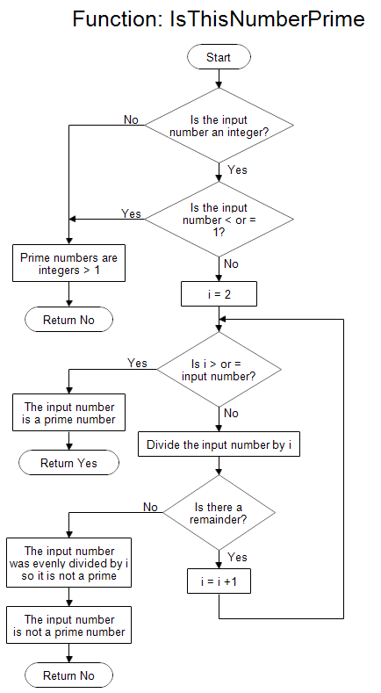

Slide 36
Factorial of a Number..?

Slide 37
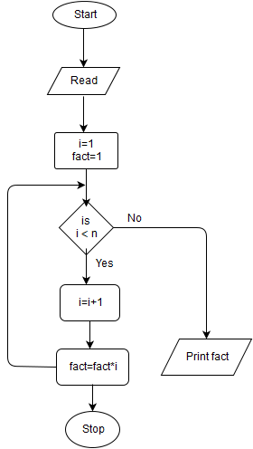

Slide 38
Decision Table
A decision table is a graphical method for explaining the logic of making decision in tabular format.
Decision table is a brief visual representation for specifying which actions to perform depending on given conditions.
It shows conditions and actions in a simplified and orderly manner.
A decision table is similar to a flow chart in use and its construction.
It may be used either independently or as a complement to a flow chart.

Slide 39
Decision Table
The general format of a decision table has four basic parts:
1. Action entry:
  It indicates the actions to be taken.
2. Condition entry:
  It indicates conditions which are being met or answers the questions in the condition stub.
3. Action stub:
  It lists statements describing all actions that can be taken.
4. Condition stub:
  It lists all conditions to be tested for factors necessary for taking a decision.

Slide 40
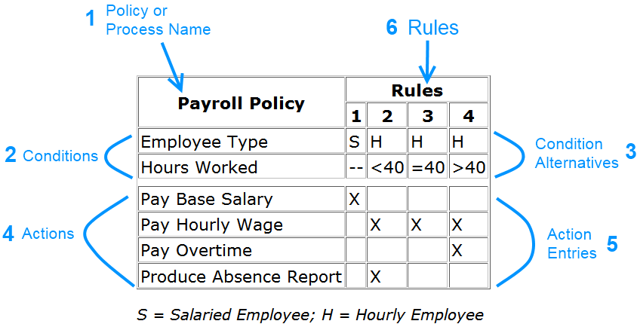
Decision Table Example

Slide 41
Decision Table Example
For example, Rule 1 states that if an employee is salaried, it doesn't matter how many hours they worked: the action will always be to pay them their base salary. In this example, we are indifferent to the value of the "hours worked" condition - it's value doesn't matter.

Slide 42
Decision Table Example
Rule 2: If an employee is hourly and works less than 40 hours, pay them their hourly wage and produce an absence report for this employee.
Rule 3: If an employee is hourly and works exactly forty hours, pay them their hourly wage.

Slide 43
Advantages of Decision table
It provides compact representation of decision making process.
Tables are easier to draw up than comparable flow charts. They are easier to change since it is a relatively simple matter to add conditions, rules and actions to a table.
Tables force the programmer to think the problem through. For example, if there are three conditions to be considered, each of which can be answered yes or no, then there are 2³ or 8 possible paths or rules.
The structure of decision table promotes a logically complete and consistent problem definition.

Slide 44
Disadvantages of Decision Table
It cannot express the complete sequence of operations to solve a problem therefore it may be difficult for the programmer to translate decision table into program.
If there are too many alternatives, it is difficult to list in decision table.
It does not show the flow of logic for the solution to a given problem.

Slide 45
Algorithm
An algorithm is a well-defined step by step solution or a series of instructions to solve a problem.
Algorithms help to do a task in programming to get the expected output.
The Algorithm designed are language-independent, i.e. they are just plain instructions that can be implemented in any language, and yet the output will be the same, as expected.

Slide 46
Characteristics of an Algorithm
Clear and Unambiguous: Algorithm should be clear and unambiguous. Each of its steps should be clear in all aspects and must lead to only one meaning.
Well-Defined Inputs: If an algorithm says to take inputs, it should be well-defined inputs.
Well-Defined Outputs: The algorithm must clearly define what output will be yielded.

Slide 47
Characteristics of an Algorithm
Finiteness: The algorithm must be finite, i.e. it should not end up in an infinite loops or similar.
Feasible: The algorithm must be simple, generic and practical, such that it can be executed upon with the available resources. It must not contain some future technology, or anything.
Language Independent: The Algorithm designed must be language-independent, i.e. it must be just plain instructions that can be implemented in any language, and yet the output will be same, as expected.

Slide 48
Algorithm
In order to write an algorithm, following things are needed as a pre-requisite:
The problem that is to be solved by this algorithm.
The constraints of the problem that must be considered while solving the problem.
The input to be taken to solve the problem.
The output to be expected when the problem the is solved.
The solution to this problem, in the given constraints.
Then the algorithm is written with the help of above parameters such that it solves the problem.

Slide 49
Example: Algorithm to add 3 numbers and print their sum:
START
Declare 3 integer variables num1, num2 and num3.
Take the three numbers, to be added, as inputs in variables num1, num2, and num3 respectively.
Declare an integer variable sum to store the resultant sum of the 3 numbers.
Add the 3 numbers and store the result in the variable sum.
Print the value of variable sum
END

Slide 50
Algorithm, Pseudocode and Program
Algorithm : Systematic logical approach which is a well-defined, step-by-step procedure that allows a computer to solve a problem.
Pseudocode : It is a simpler version of a programming code in plain English which uses short phrases to write code for a program before it is implemented in a specific programming language.
Program : It is exact code written for problem following all the rules of the programming language.

Slide 51
Difference between Algorithm, Pseudocode and Program

Slide 52
Structured Programming Concepts
Structured Programming Approach, can be defined as a programming approach in which the program is made as a single structure. It means that the code will execute the instruction by instruction one after the other.
It doesn’t support the possibility of jumping from one instruction to some other with the help of any statement like GOTO, etc. Therefore, the instructions in this approach will be executed in a serial and structured manner.

Slide 53
Structured Programming Concepts
The structured program consists of well structured and separated modules. But the entry and exit in a Structured program is a single-time event. It means that the program uses single-entry and single-exit elements. Therefore a structured program is well maintained, neat and clean program.

Slide 54
Structured Programming Concepts
The structured program mainly consists of three types of elements:
    Sequence Statements
    Selection Statements
    Iteration Statements
The first is sequencing, which has to do with the logical sequence provided by the statements in the program. As they are executed, each step in the sequence must logically progress to the next without producing any undesirable effects.

Slide 55
Structured Programming Concepts
The second element is selection. This step allows the selection of any number of statements to execute in the program. These statements will contain certain keywords that can identify the sequence as a logically ordered executable. These terms are “if," “then," “endif," or “switch.“
A third element is repetition. As a program proceeds, a statement continues to be active until the program gets to the point where some other action needs to take place. The keywords include "repeat," “for," or “do…until.”

Slide 56
Advantages of Structured Programming
Easier to read and understand
User Friendly
Easier to Maintain
Mainly problem based instead of being machine based
Development is easier as it requires less effort and time
Easier to Debug
Machine-Independent, mostly.

Slide 57
Disadvantages of Structured Programming
Since it is Machine-Independent, So it takes time to convert into machine code.
The program depends upon changeable factors like data-types. Therefore it needs to be updated with the need on the go.

Slide 58
Programming Methodologies
Top-Down and Bottom-up Programming
Program Design: Program design is the process of converting a set of requirements into a collection of commands or a program that can be executed on a computer system. A program is a series of instructions that the computer executes in order to perform some meaningful work.

Slide 59
Top-Down Programming
Top down program design is an approach to program design that starts with the general concept and repeatedly breaks it down into its component parts. In other words, it starts with the abstract and continually subdivides it until it reaches the specific.
The basic idea in top-down approach is to break a complex algorithm or a problem into smaller segments called modules, this process is also called as modularization. The modules are further decomposed until there is no space left for breaking the modules without hampering the originality.

Slide 60
Top-Down Programming
Example: Consider creating the prime factorization of a number like 1540. The steps involved might look like:
1540
2 x 770
2 x 2 x 385
2 x 2 x 5 x 77
2 x 2 x 5 x 7 x 11

Slide 61
Bottom-up Programming
Bottom up program design works in the exact opposite way. It starts with the component parts and repeatedly combines them to achieve the general concept. In other words, it starts with the specific and continually combines it until it reaches the abstract.
In this approach we start working from the most basic level of problem solving and moving up in conjugation of several parts of the solution to achieve required results. The most fundamental units, modules and sub-modules are designed and solved individually, these units are then integrated together to get a more concrete base to problem solving.

Slide 62
Bottom-up Programming
Example: Consider the factorization of 1540. For bottom up design the steps involved might look like:
2 x 2 x 5 x 7 x 11
2 x 2 x 5 x 77
2 x 2 x 385
2 x 770
1540

Slide 63
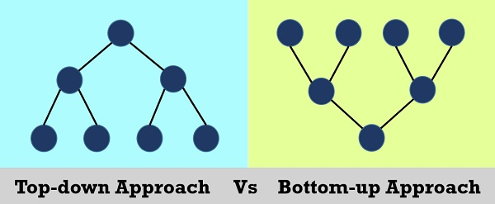
Top- Down | Bottom-up
Divides a problem into smaller units and then solve it. | Starts from solving small modules and adding them up together
This approach contains redundant information. | Redundancy can easily be eliminated.
A well-established communication is not required. | Communication among steps is mandatory.
The individual modules are thoroughly analyzed. | Works on the concept of data-hiding and encapsulation.
Structured programming languages such as C uses top down approach. | OOP languages like C++ and Java etc. uses bottom-up mechanism.
Relation among modules is not always required. | The modules must be related for better communication and work flow.

Slide 64
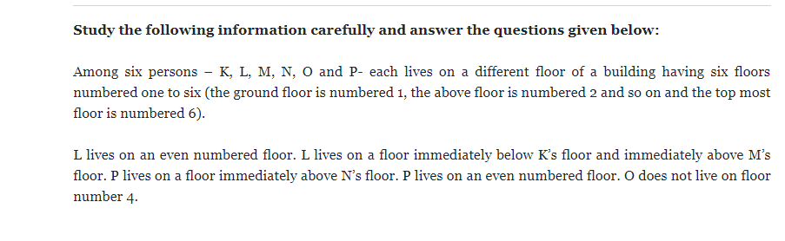
bo
Q:1 Who lives on a floor immediately above P’s floor?
Q:2 On which floor does N live?
Q:3 Who amongst the following does live on 5th floor?
Q:4 On which floor does O live?
Q:5 Who amongst the following live on the floors exactly between K and P?

Slide 68
Answers
M
1st
K
6th
L and M

Slide 69
O
K
L
M
P
N

